Slide 1
Human Subjects Office IRB Submissions and KC Demostration
Senta Baker
Sharon Moran
IU Human Subjects Office

Slide 2
Why Is the IRB necessary?
Human subjects research was unregulated and often relied upon marginalized groups
Subjects could be exposed to physical and/or psychological harm without their consent or knowledge
Subjects could be coerced or intimidated into participating in research

Slide 3
Role of the IRB: Protect Human Subjects
Approve, require modifications in, or disapprove research activities
Conduct initial and continuing review of ongoing research at least annually
Approve any changes in research activities prior to changes being initiated
Evaluate any unanticipated problems involving risks to subjects or others or any serious or continuing noncompliance
May suspend or terminate IRB approval

Slide 4
Researcher Responsibilities
IU researchers must complete the appropriate CITI course on human subjects research, social behavioral researcher stage 1
Proposed research project must be submitted to the Human Subjects Office for review prior to any work being conducted
Researchers may not begin their work until approval has been received

Slide 5
Types of IRB Review
Exempt Review
exempt from being reviewed yearly by the IRB
Expedited Review
Full Board Review

Slide 6
EXEMPT
Observation of public behavior
Collection of existing data
Surveys and/or interviews
Educational; example how a child learns music

Slide 7
EXPEDITED
Surveys, interviews
Prospective collection of data
Research on individual or group characteristics
Research employing oral history, focus groups, or program evaluation

Slide 8
FULL COMMITTEE
Experimental drug or device studies
Most invasive procedures
Surveys/interviews that include sensitive questions or questions that are likely to be stressful to the subject
Many types of research involving children, pregnant women and fetuses, cognitively impaired, and research involving prisoners

Slide 9
What documents are needed
Complete the online questionnaire (replaces the old exempt checklist and summary safeguard)
Recruitment materials, how will you invite them to participate, if you call or email we will need to have a copy of the telephone scripts, emails that will be used.
Final survey, sample of the interview questions
Study information sheet

Slide 10
Changes to and Continuing Research
Once a study is approved, no changes can be initiated until IRB approval has been given for those changes
The IRB must review ongoing non-exempt research at least annually if federally funded, non federal studies receive a 2 year approval

Slide 11
Questions?

Slide 12
IRB Process Workflow
Researcher Submission
KC IRB
one.iu.edu  search: KC IRB

Slide 13
TRAINING ENVIRONMENT

Slide 14
TRAINING ENVIRONMENT

Slide 15
KC SUPPORT & HELP

Slide 16
TRAINING ENVIRONMENT

Slide 17
IRB Process Workflow
Researcher Submission
Resources
http://researchcompliance.iu.edu/hso/index.html
http://researchcompliance.iu.edu/hso/hs_level_review.html
http://researchcompliance.iu.edu/hso/hs_getting_started.html
http://researchcompliance.iu.edu/hso/hs_submission.html
http://researchcompliance.iu.edu/hso/hs_review.html
http://researchcompliance.iu.edu/hso/hs_post_approval.html
http://researchcompliance.iu.edu/hso/hs_forms.html
http://researchcompliance.iu.edu/hso/hs_guidance.html
http://researchcompliance.iu.edu/hso/hs_faq.html
http://researchcompliance.iu.edu/hso/hs_education.html

Slide 18
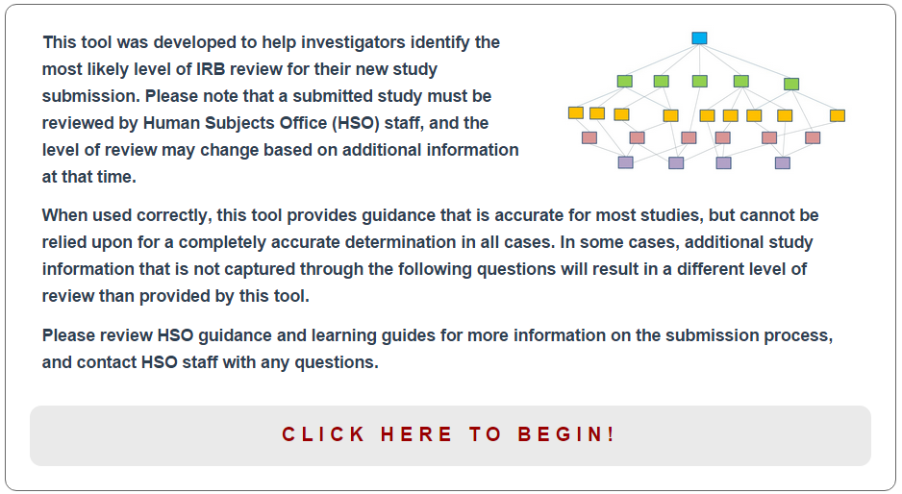
IRB Process Workflow
Researcher Submission
Resources
Protocol Decision Tree

Slide 19
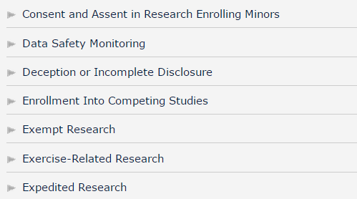
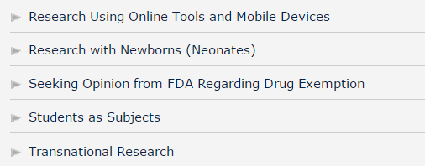
IRB Process Workflow
Researcher Submission
Resources
Guidance

Slide 20
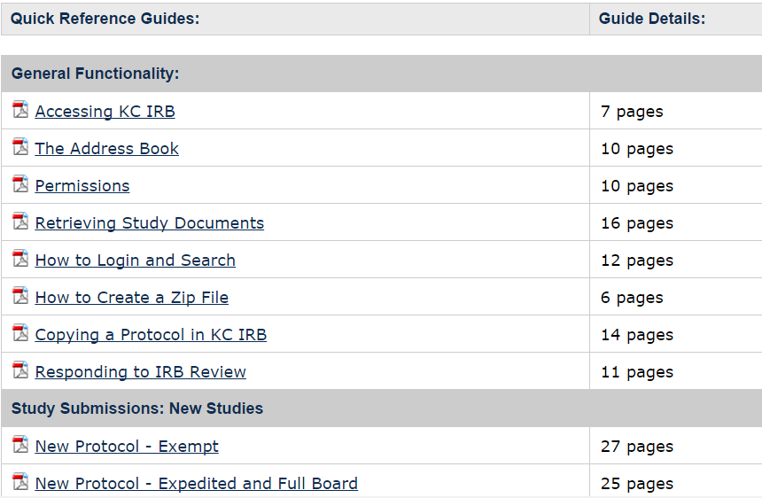
IRB Process Workflow
Researcher Submission
Resources
Training Guides

Slide 21
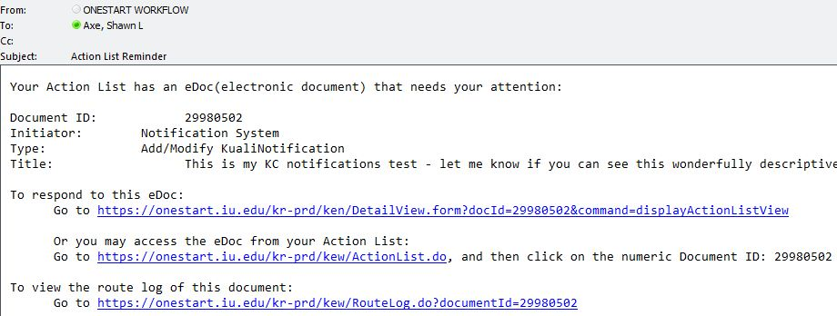
IRB Process Workflow
Staff Review
Action List – Email Notification
Staff pre-review sent to researcher
Return to PI

Slide 22
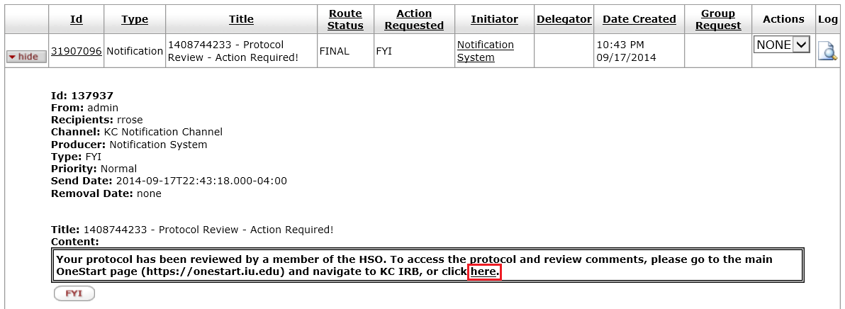
IRB Process Workflow
Staff Review
Action List
Staff pre-review sent to researcher
Return to PI

Slide 23
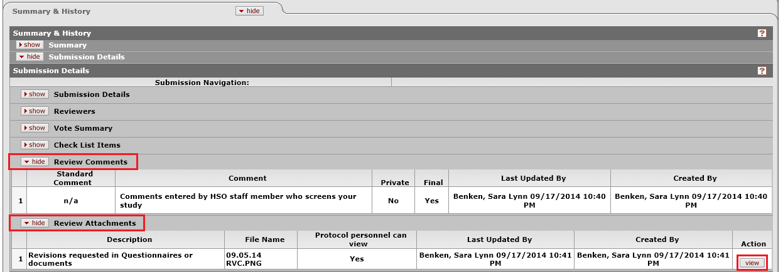
IRB Process Workflow
Staff Review
KC IRB – Review Comments/Attachments
Staff pre-review sent to study team
Protocol Status = Return to PI

Slide 24
IRB Process Workflow
Outtake
Approval
Approval Letter
Signed Protocol Summary
Consent Documents (PDF) – receive watermark when viewed/downloaded from KC
Notification

Slide 25
IRB Process Workflow
Outtake
KC IRB

Slide 26
Questions?

Slide 27
CONTACT
IU Human Subjects Office
Senta Baker, skbaker@iu.edu, 812-855-0945
Sharon Moran, morans@iu.edu, 812-856-4242

